Slide 1





Slide 2



De Harbor a Kubernetes
Un Recorrido Guiado por GitOps para CI/CD Seguro

Slide 3

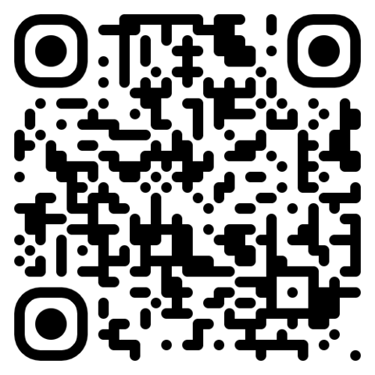
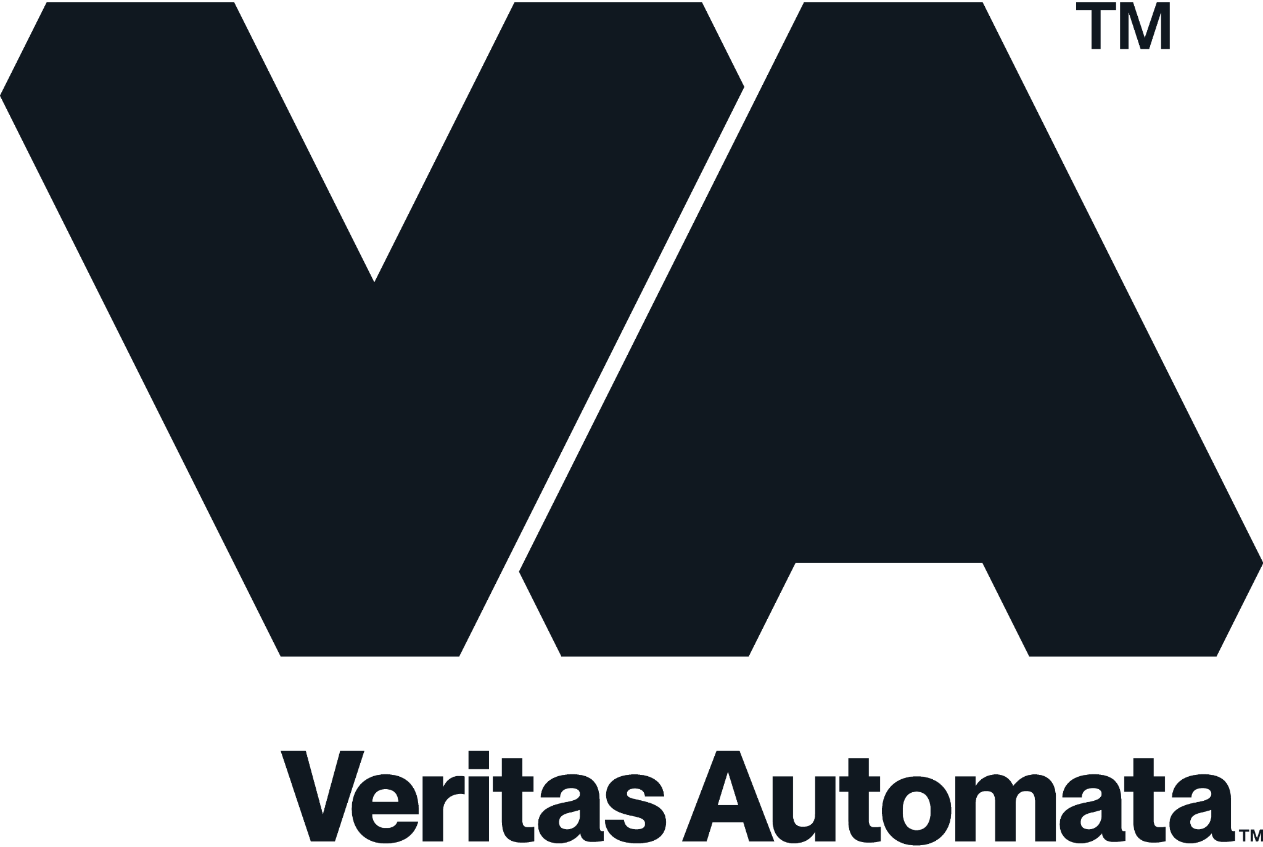

Fabrizio Sgura
Chief Engineer
Medellin, COL
My job is my favorite game

Slide 4
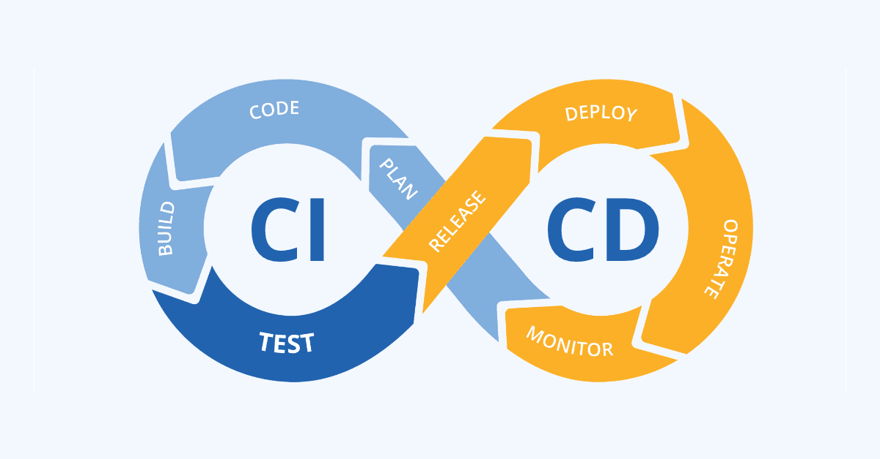
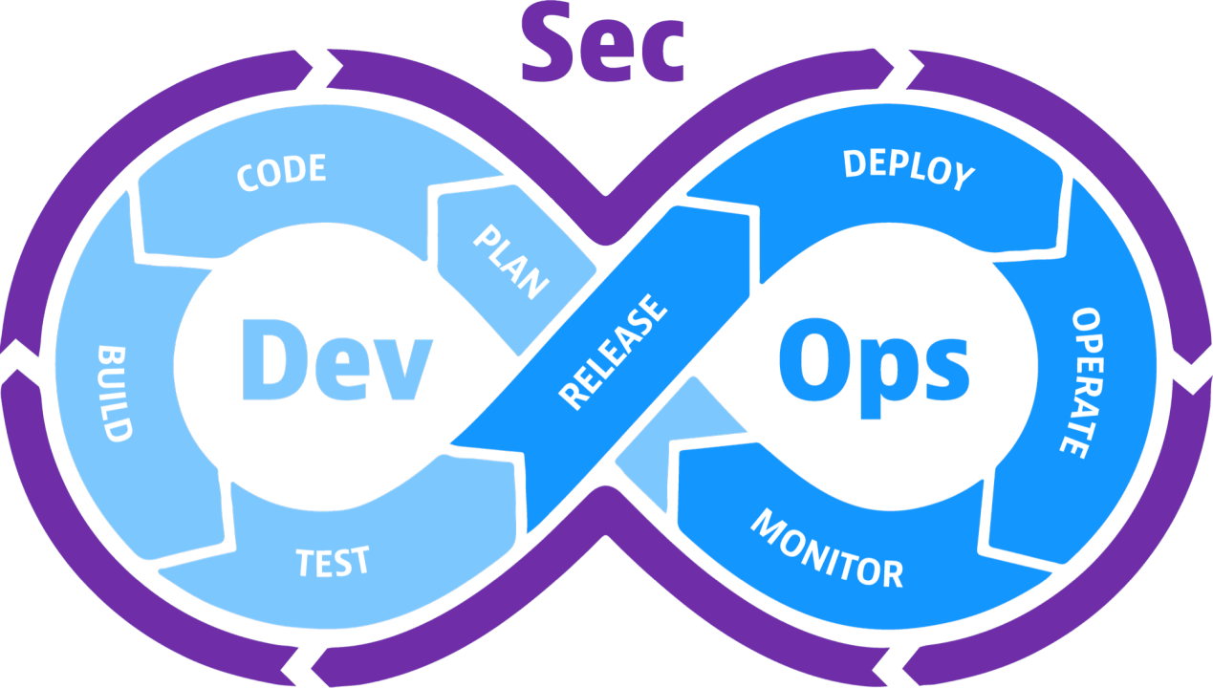
AGENDA
What is GitOps
Why GitOps
Introducting Harbor
Secure your images
Extending Harbor Security
Image Distribution at scale
Securing the Delivery Path
Workshop Lab
Summary and Takeaways

Slide 5



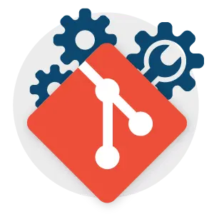



WHAT IS GITOPS?
Declarative infrastructure as code
Version-controlled state in Git
Automated reconciliation
Auditable, repeatable, secure
Do you know these logos?

Slide 6
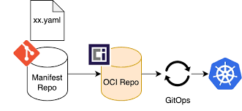
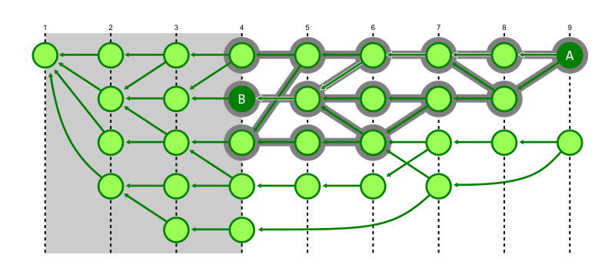
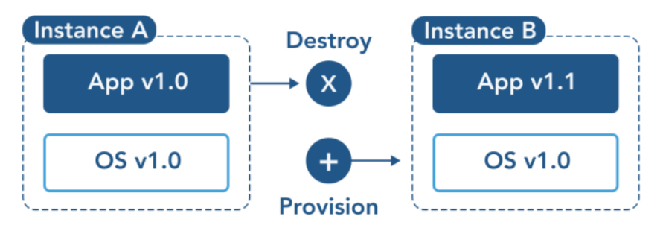

WHY GITOPS IN CI/CD?
Pipeline transparency
Rollbacks via Git History
Immutable deployment artifacts
Built-in approval workflows

Slide 7


INTRODUCING HARBOR
Cloud-native OCI registry
Role-based access control
CVE scanning & policy management
Interoperability with Kubernetes & GitOps

Slide 8
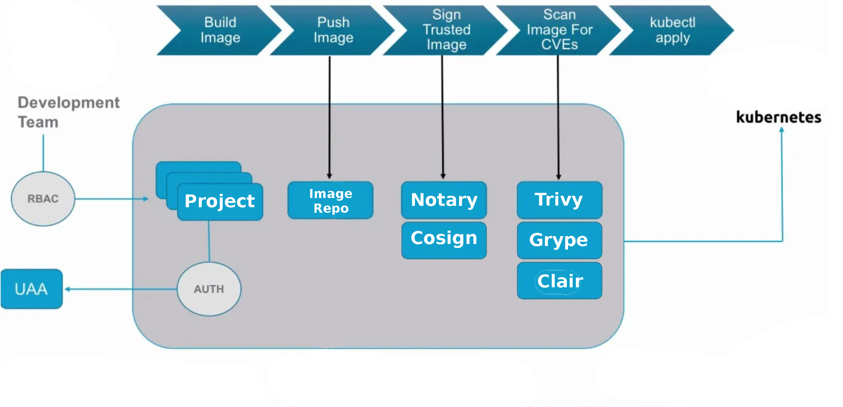
SECURE YOUR IMAGES
Integrated with Harbor
Scans images, Dockerfiles, SBOMs
Highlights: CVEs, misconfigurations, secrets
supports Git repos, Kubernetes manifests, Terraform

Slide 9

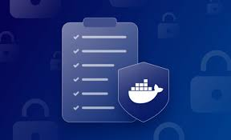
EXTENDING HARBOR SECURITY
Add multiple scanners, like Grype, Clair
Configure CVE whitelists & policies
Enforce artifact signing with Cosign
Generate SBOMs with Trivy or Syft

Slide 10
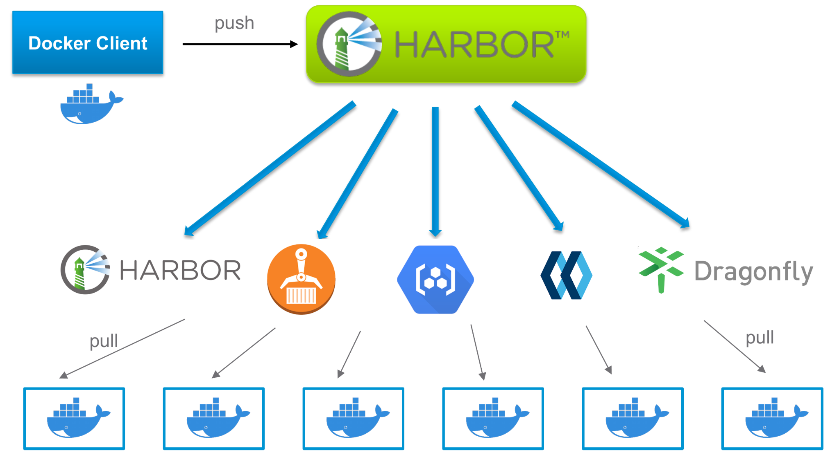
IMAGE DISTRIBUTION AT SCALE
P2P-based image & file distribution
Reduces load on registry
Kubernetes-native integration
Edge and hybrid cluster friendly

Slide 11
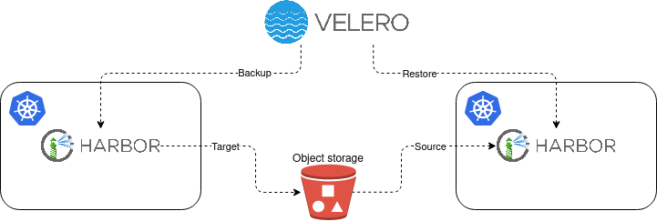
A LOT OF ADDITIONAL INTEGRATIONS
Disaster recovery
Persistence
Velero Integration
Migrations and Standby Replicas

Slide 12
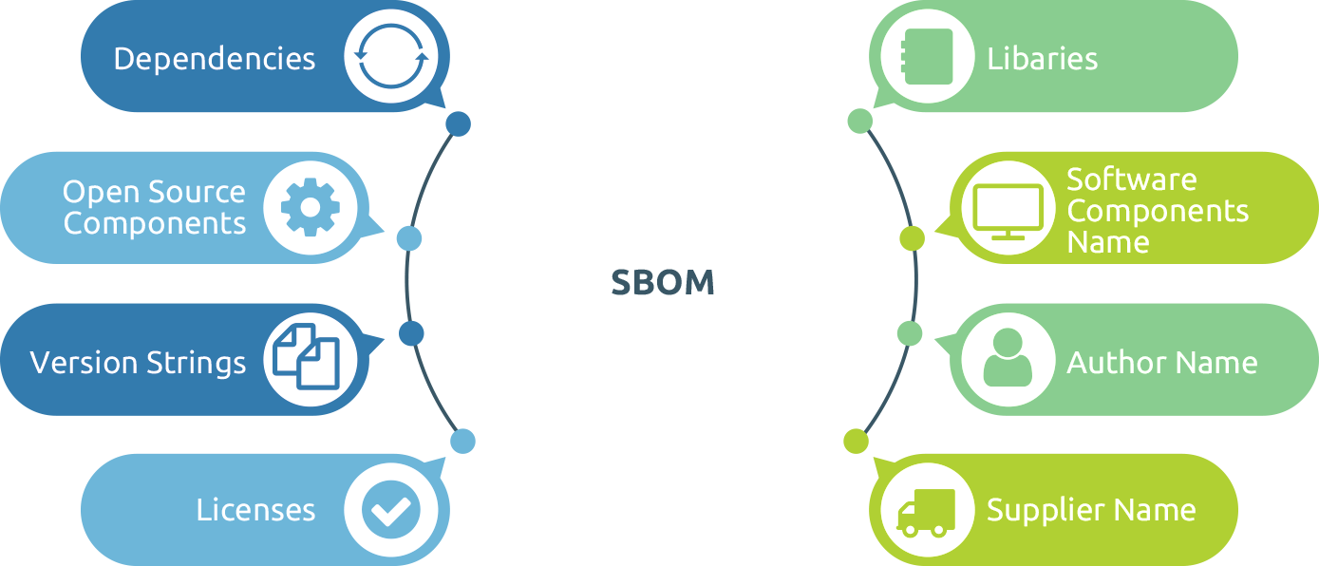
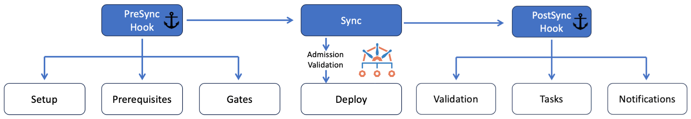
SECURING THE DELIVERY PATH
We can add security to the whole delivery path!
SBOMs: Software Bill of Materials
Helm chart linting & signing
Policy enforcement with Kyverno/OPA
GitOps sync verification

Slide 13
DEMO - WORKSHOP ROADMAP

Slide 14
THANK YOU
Fabrizio Sgura
Chief Engineer
Medellin, COL
My job is my favorite game

Slide 15

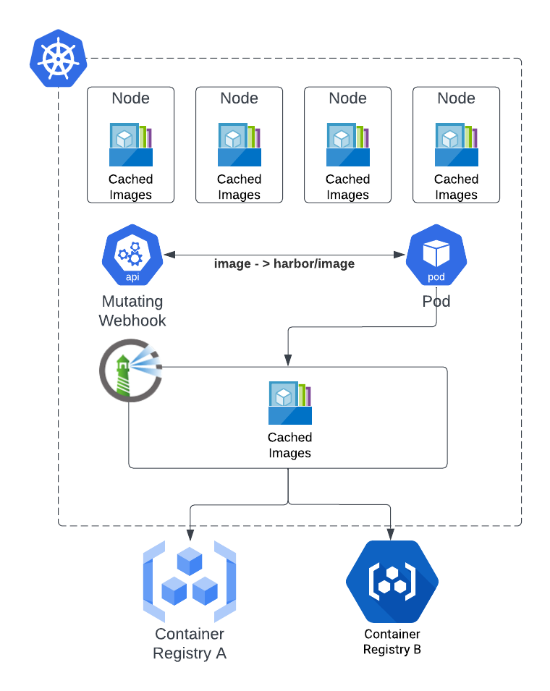

Slide 16
1
2
Texto aquí
Texto aquí
3
4
Texto aquí
Texto aquí

